Slide 1
wedding photo booth rental in long beach
https://sites.google.com/view/photoboothrentalslosanges/home
Notes:
https://drive.google.com/file/d/1QD3dkzCdwUP54Hd3mMBhbl9ZdEzUOhaM/view?usp=sharing
https://drive.google.com/file/d/1hmROdzls56clRiehqcNOfnhGpktj1lDU/view?usp=sharing
https://drive.google.com/file/d/1H5aEULi1xycOrg4lIMnIo7MX_7WW4g4C/view?usp=sharing
https://docs.google.com/document/d/1XCJbDdYOuaOR1lOnC8Mf_zJerirKloF-HgAwTENyv3A/edit?usp=sharing
https://docs.google.com/document/d/1XCJbDdYOuaOR1lOnC8Mf_zJerirKloF-HgAwTENyv3A/pub
https://docs.google.com/document/d/1XCJbDdYOuaOR1lOnC8Mf_zJerirKloF-HgAwTENyv3A/view
https://docs.google.com/presentation/d/1iR5xWaQmDRu8pRLZRT-3-pm0MEZsBd83pbrXIHmGix8/edit?usp=sharing
https://docs.google.com/presentation/d/1iR5xWaQmDRu8pRLZRT-3-pm0MEZsBd83pbrXIHmGix8/pub?start=true&loop=true&delayms=3000
https://docs.google.com/presentation/d/1iR5xWaQmDRu8pRLZRT-3-pm0MEZsBd83pbrXIHmGix8/view
https://docs.google.com/presentation/d/1iR5xWaQmDRu8pRLZRT-3-pm0MEZsBd83pbrXIHmGix8/htmlpresent

Slide 4
wedding photo booth rental in long beach
The Selfie Station is a modern photo booth that offers an interactive experience your guests will love. The selfie station provides a fun and memorable way for guests to share their event experience with friends and family on social media. Selfie Station Rental is a selfie station that you can rent. Rental includes delivery, setup and pickup in Los Angeles and Orange County. It's the newest high-quality selfie station that businesses love and enthusiasts, increasing attendance at your events while offering premium tax deductions. Selfie Station Rental in Los Angeles is an exciting new way to engage your audience. The Selfie Station is well known as a value-added tool for businesses in the US and Europe. We are excited to announce that we are now renting selfie stations in Los Angeles. As people become more actively involved in social media, renting a selfie station is a great way to increase social media participation. It also makes the event more memorable and enjoyable. The Selfie Station is a photo booth modified for more fun. We've added touch screens, lights and other value-added features to the classic photo booth so you can take great pictures of you and your friends and family. Selfie station rental is the next evolution in photography . This is a modern, highly interactive touchscreen photo booth that captures both high quality video and still images. The Selfie Station is designed for serious business people and event planners. Whether you're renting a selfie station for a corporate event, wedding, or trade show booth, we have a solution for you. Renting a selfie station is a value-added photo booth that provides an engaging experience for your guests and increases attendance at your event. Selfie Station Rental Los Angeles is a company that offers selfie station rentals for parties, corporate events and weddings.
https://sites.google.com/view/photoboothrentalslosanges/home
Notes:
wedding photo booth rental in long beach,photo booth rental prices long beach,photo booth rental in long beach

Slide 5
Contact Information
Lucky Frog Photo Booth | 360 Video Booth Rental Los Angeles
532 S Olive St, Los Angeles, CA 90013
562-303-9926
Notes:
Lucky Frog Photo Booth | 360 Video Booth Rental Los Angeles532 S Olive St, Los Angeles, CA 90013562-303-9926

Slide 6
More info about us:
wedding photo booth rental in long beach
photo booth rental prices long beach
photo booth rental in long beach
Notes:
Lucky Frog Photo Booth | 360 Video Booth Rental Los Angeles532 S Olive St, Los Angeles, CA 90013562-303-9926

Slide 7
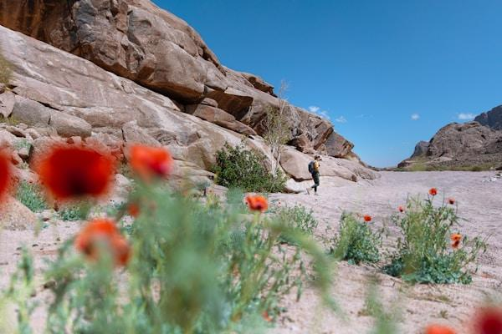

Slide 8
Links
List of recommended resources
Notes:
wedding photo booth rental in long beach,photo booth rental prices long beach,photo booth rental in long beach

Slide 9
Please visit :
photo
photo
photo
document
document pub
document view
presentation
presentation pub
presentation view
presentation html
Notes:
https://drive.google.com/file/d/1QD3dkzCdwUP54Hd3mMBhbl9ZdEzUOhaM/view?usp=sharing
https://drive.google.com/file/d/1hmROdzls56clRiehqcNOfnhGpktj1lDU/view?usp=sharing
https://drive.google.com/file/d/1H5aEULi1xycOrg4lIMnIo7MX_7WW4g4C/view?usp=sharing
https://docs.google.com/document/d/1XCJbDdYOuaOR1lOnC8Mf_zJerirKloF-HgAwTENyv3A/edit?usp=sharing
https://docs.google.com/document/d/1XCJbDdYOuaOR1lOnC8Mf_zJerirKloF-HgAwTENyv3A/pub
https://docs.google.com/document/d/1XCJbDdYOuaOR1lOnC8Mf_zJerirKloF-HgAwTENyv3A/view
https://docs.google.com/presentation/d/1iR5xWaQmDRu8pRLZRT-3-pm0MEZsBd83pbrXIHmGix8/edit?usp=sharing
https://docs.google.com/presentation/d/1iR5xWaQmDRu8pRLZRT-3-pm0MEZsBd83pbrXIHmGix8/pub?start=true&loop=true&delayms=3000
https://docs.google.com/presentation/d/1iR5xWaQmDRu8pRLZRT-3-pm0MEZsBd83pbrXIHmGix8/view
https://docs.google.com/presentation/d/1iR5xWaQmDRu8pRLZRT-3-pm0MEZsBd83pbrXIHmGix8/htmlpresent

Slide 10
wedding photo booth rental in long beach
https://sites.google.com/view/photoboothrentalslosanges/home
Notes:
wedding photo booth rental in long beach,photo booth rental prices long beach,photo booth rental in long beach

